Slide 1
MyAnatomy project
Team name : Data Pirates
M.Kumarasamy College of Engineering

Slide 2
Problem Statement:
To detect the unwanted and malicious content that enter into one’s device which may harm their personal details.

Slide 3
Solution:
65% of people today are using chrome browser for surfing.
The proposed problem can be solved by creating a chrome extension.
This detects the malicious content in the internet and intimates the user.

Slide 4
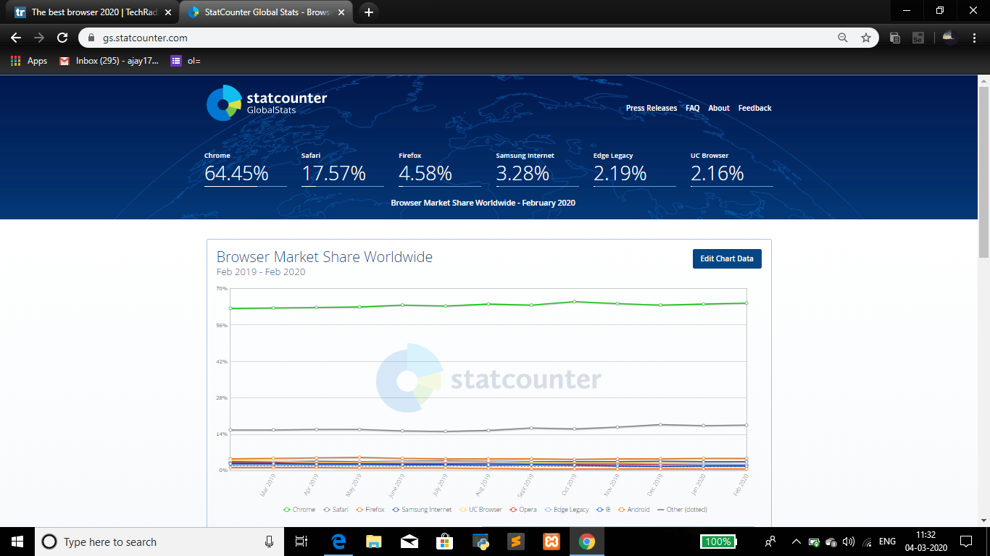

Slide 5
Value Proposition:
Sociable
Security based
Simple to use
Portable
How it is useful to user?
Helps user to protect their personal details.

Slide 6
Differentiation:
This project differs from others by preventing the harmful links and websites to access our private stuffs that are stored in our devices like mobile phones and computers etc,.

Slide 7
Core technology:
Random Forest Algorithm.
HTML, CSS, JAVASCRIPT, JSON and PHP
Apache Xampp server V3.2.4
JetBrains PyCharm Community Edition

Slide 8
Random Forest Algorithm
Random forest algorithm create decision tree on the data sample and then gets the prediction from each of them and finally selects the best solution by means of voting.
In this project it can be used for the purpose of analyzing the malicious links.

Slide 9
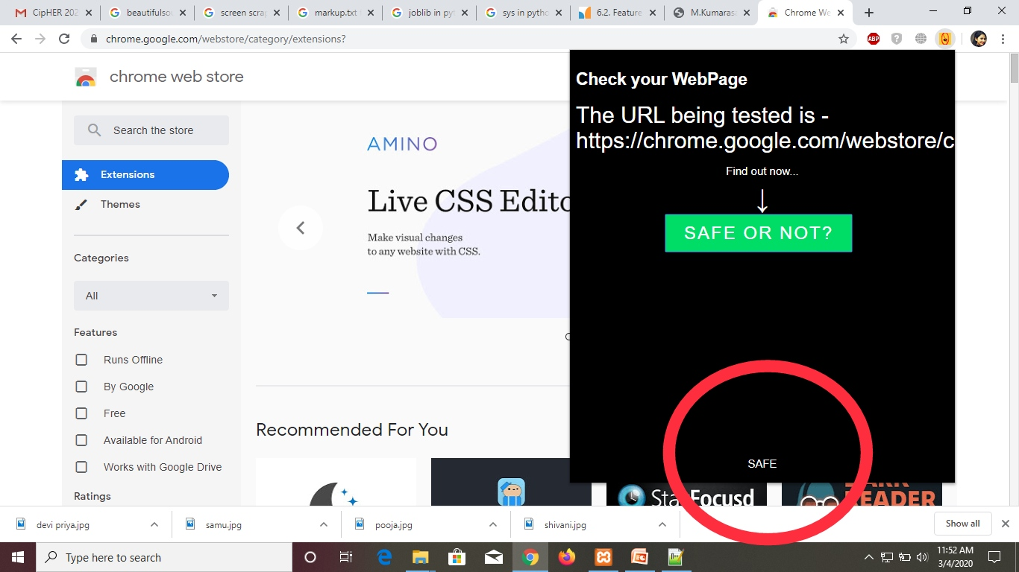
Snapshot

Slide 10
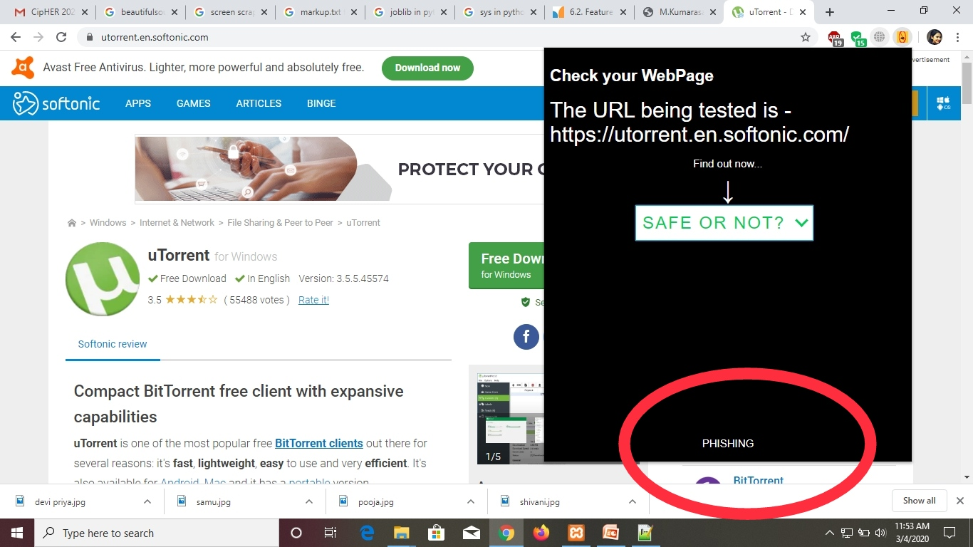

Slide 11
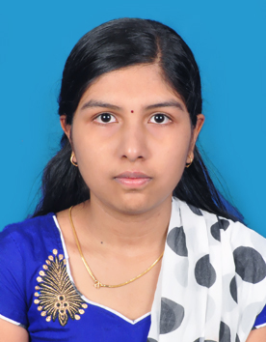
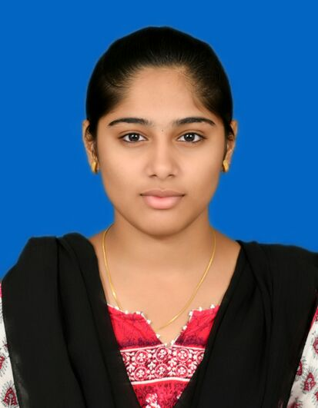
Team Introduction
Team members :
P.Shivani,
3rd year-Computer Science and Engineering,
M.Kumarasamy College of Engineering,
karur.
D.Pooja
3rd year-Computer Science and Engineering,
M.Kumarasamy College of Engineering,
Karur.

Slide 12
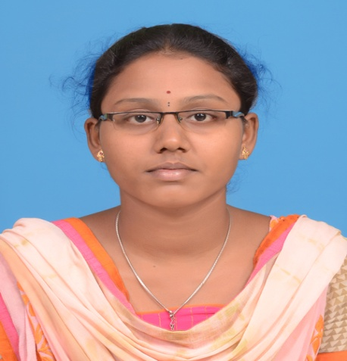
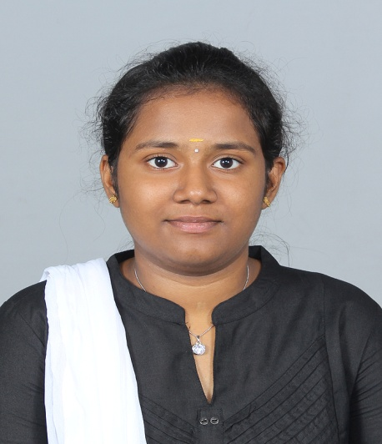
M.Samundeeswari
3rd year-Computer Science and Engineering,
M.Kumarasamy College of Engineering,
Karur.
P.Devipriya
3rd year-Computer Science and Engineering,
M.Kumarasamy College of Engineering,
Karur.

Slide 13
Source code link:
https://github.com/shivanipalanikumar/MyAnatomy
Video link:
https://youtu.be/XudZRwOYi24

Slide 14
Conclusion
Thus a chrome extension can be created to notify the user, when a malicious link is accessed.
If the user still wants to use the link they can continue by ignoring the extension notification.

